Slide 1
Database Development
Analysis & Design

Slide 2
Software Development Lifecycle
Requirements Analysis: SRS
Design: Design Document
Implementation: Software (partially covered in PART I : Query Languages)
Testing
Installation
Maintenance

Slide 3
Software Development Lifecycle
Traditional lifecycle
  Sequential
  Real projects rarely follow it
Spiral lifecycle
  Suitable for unknown domain
  Partial development of each phase
Prototyping lifecycle
  User involvement large
  User interface issues important
Iterative lifecycle (we are going to follow)

Slide 4
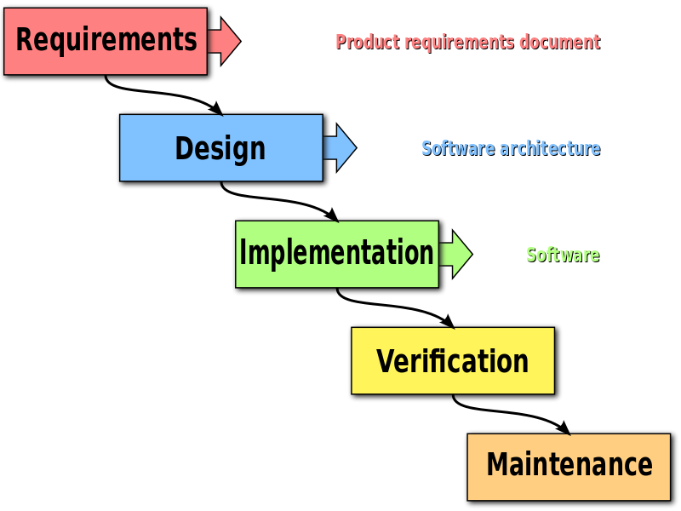
Waterfall/ Sequential SDLC

Slide 5
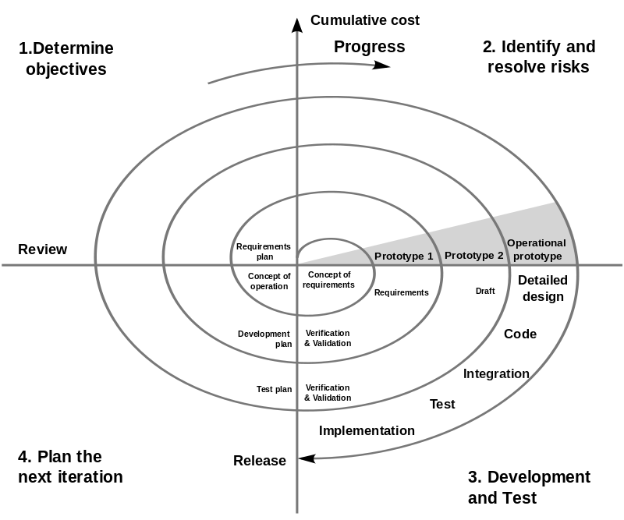
Spiral SDLC

Slide 6
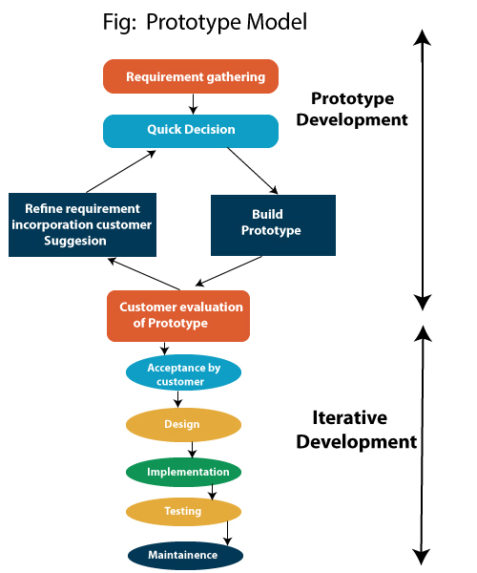
Prototype SDLC

Slide 7
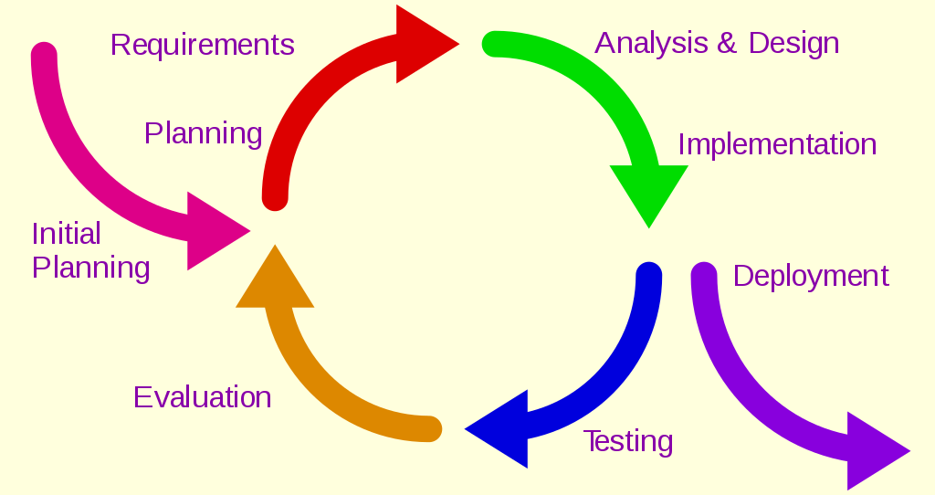
Iterative SDLC

Slide 8
Database Development
Problem Definition
Requirements Analysis
System Requirements Specification (SRS)
Conceptual Design (E-R, E-R to Relational, Schema Refinement)
Physical Database Design (data volume, performance criteria, tuning)
Hierarchy of users and securities
Implementation
Testing
Maintenance

Slide 9
Database Design Process
Requirements Analysis
  What data?
  Categories of users
  Constraints
Conceptual Design
  High level description of data
  Entity-Relationship model can be used
Logical Design
  E-R to Relational Mapping
Schema Refinement
  Analyze collection of relations
  Identify potential problems
  Normalization

Slide 10
Database Design Process
Physical Database Design
  Database load
  Performance criteria
  Building indexes on tables
  Clustering tables
  Database tuning
Application and Security Design
  Hierarchy of users and access
The complete design requires tuning where all these steps are interleaved and repeated until design is acceptable

Slide 11
Analysis & Design
Analysis: A description of the problem & requirements: what the problem is about and what a system must do?
Design: High level & detailed descriptions of the logical solution & how it fulfills requirements & constraints

Slide 12
Requirements Analysis
What data is to be stored in the database?
What users want from the system?
Frequent queries, performance requirements (functional/ non-functional)
Discussions with potential users, study of the existing system, study of the available documents, questionnaire
The output is SRS System’s Requirements Specification
Well documented using the appropriate templates

Slide 13
Analysis
Problems
  Communication gap
  Facts will rarely emerge in a neatly ordered fashion
  Facts found by the developers are usually detailed, unstructured and sometimes conflicting
  Clear, precise documentation

Slide 14
Requirements
Create a specification of the problem domain & the requirements from the perspective of
  Classification by objects
  Understanding the terms used in the problem domain
Conceptual model does not describe software components, it represents concepts in real-world problem domain
Understanding the requirements includes understanding the domain processes & the role of the external entities
Functionalities/Use Cases: Textual narrative descriptions of the processes in an enterprise or system

Slide 15
Requirements
Functional: what a system does or is expected to do ( functionality)
  Descriptions of the processing the system will be required to carry out
  Details of the inputs for the system
  Details of the outputs expected from the system
  Details of the data that must be held in the system
Nonfunctional : these describe the aspects of the system that are concerned with how well the system provides the functionality
Performance criteria such as the response time for the updation of the data or retrieving the data
Anticipated volumes of data
Security considerations

Slide 16
Requirements Collection/
Fact Finding Techniques
Background Reading
Interview
Observation
Survey/ Questionnaire
Input and output of each technique
Actual FF process is a combination of any number of these 4 processes in some sequence

Slide 17
Background Reading
Company reports
Organisation charts
Policy manuals
Job description
Reports
Documentation of the existing system

Slide 18
Interviewing
Most widely used fact finding technique
Questionnaires are used if the interviewees are geographically dispersed( video conferencing??)
Requires good planning, alertness, good interpersonal skills

Slide 19
Observation
watching people carrying out their job in natural setting
Can sort out conflicting information gathered during interviews

Slide 20
Survey/ Questionnaires
Aims to obtain the views of a large number of people in a way that can be analysed statistically
Includes:
  postal, web-based and email questionnaires
  open-ended and closed questions
  gathering opinion as well as facts

Slide 21
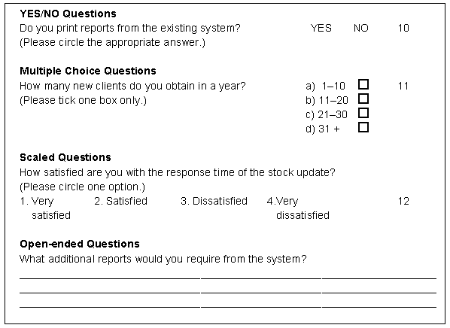


Slide 22
Database Design

Slide 23
Outline
Overview of the Design Process
The Entity-Relationship Model
Complex Attributes
Mapping Cardinalities
Primary Key
Removing Redundant Attributes in Entity Sets
Reducing ER Diagrams to Relational Schemas
Extended E-R Features
Entity-Relationship Design Issues
Alternative Notations for Modeling Data
Other Aspects of Database Design

Slide 24
Design Phases
Initial phase -- characterize fully the data needs of the prospective database users.
Second phase -- choosing a data model
  Applying the concepts of the chosen data model
  Translating these requirements into a conceptual schema of the database.
  A fully developed conceptual schema indicates the functional requirements of the enterprise.
    Describe the kinds of operations (or transactions) that will be performed on the data.

Slide 25
Design Phases
Final Phase -- Moving from an abstract data model to the implementation of the database
  Logical Design – Deciding on the database schema.
    Database design requires that we find a “good” collection of relation schemas.
    Business decision – What attributes should we record in the database?
    Computer Science decision – What relation schemas should we have and how should the attributes be distributed among the various relation schemas?
  Physical Design – Deciding on the physical layout of the database

Slide 26
Design Alternatives
In designing a database schema, we must ensure that we avoid two major pitfalls:
  Redundancy: a bad design may result in repeat information.
    Redundant representation of information may lead to data inconsistency among the various copies of information
  Incompleteness: a bad design may make certain aspects of the enterprise difficult or impossible to model.
Avoiding bad designs is not enough. There may be a large number of good designs from which we must choose.

Slide 27
Design Approaches
Entity Relationship Model
Models an enterprise as a collection of entities and relationships
    Entity: a “thing” or “object” in the enterprise that is distinguishable from other objects
      Described by a set of attributes
    Relationship: an association among several entities
  Represented diagrammatically by an entity-relationship diagram:
Normalization / Schema Refinement
  Formalize what designs are bad, and test for them

Slide 28
Entity- Relationship E-R Model

Slide 29
ER model -- Database Modeling
The ER data mode was developed to facilitate database design by allowing specification of an enterprise schema that represents the overall logical structure of a database.
The ER data model employs three basic concepts:
  entity sets,
  relationship sets,
  attributes.
The ER model also has an associated diagrammatic representation, the ER diagram, which can express the overall logical structure of a database graphically.

Slide 30
Entity Sets
An entity is an object that exists and is distinguishable from other objects.
  Example: specific person, company, event, plant
An entity set is a set of entities of the same type that share the same properties.
  Example: set of all persons, companies, trees, holidays
An entity is represented by a set of attributes; i.e., descriptive properties possessed by all members of an entity set.
  Example:
  instructor = (ID, name, salary )
  course= (course_id, title, credits)
A subset of the attributes form a primary key of the entity set; i.e., uniquely identifying each member of the set.

Slide 31
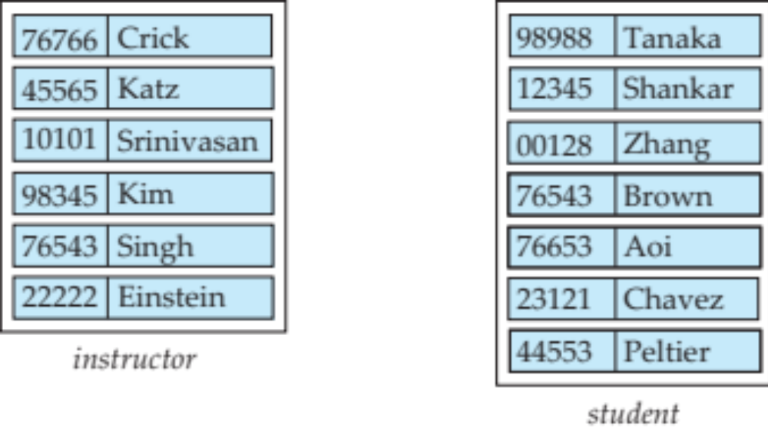
Entity Sets -- instructor and student

Slide 32
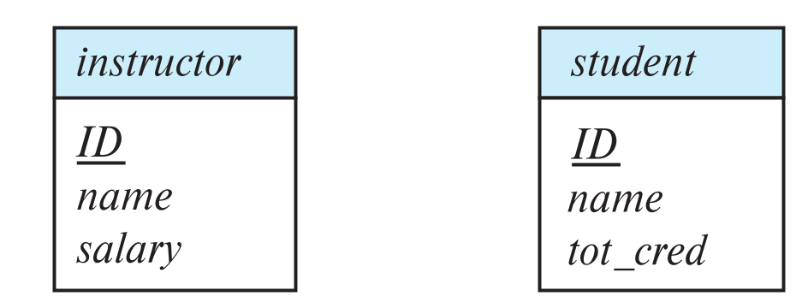
Representing Entity sets in ER Diagram
Entity sets can be represented graphically as follows:
  Rectangles represent entity sets.
  Attributes listed inside entity rectangle
  Underline indicates primary key attributes

Slide 33
Relationship Sets
A relationship is an association among several entities
Example:
44553 (Peltier) advisor 22222 (Einstein)
student entity relationship set instructor entity
A relationship set is a mathematical relation among n ≥ 2 entities, each taken from entity sets
{(e₁, e₂, … e_{n}) | e₁ ∈ E₁, e₂ ∈ E₂, …, e_{n} ∈ E_{n}}
where (e₁, e₂, …, e_{n}) is a relationship
  Example:
  (44553,22222) ∈ advisor

Slide 34
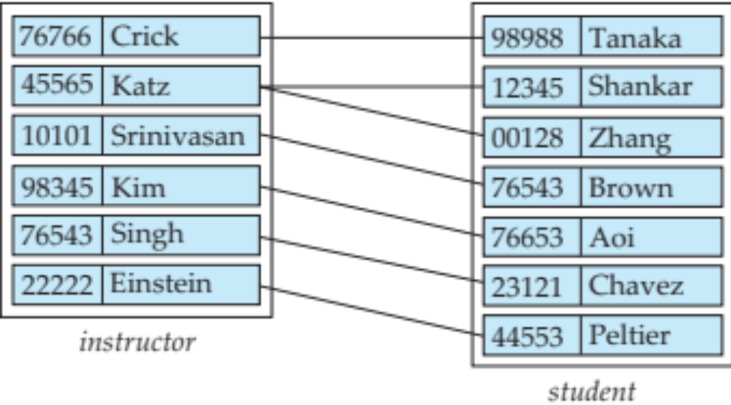
Relationship Sets
Example: we define the relationship set advisor to denote the associations between students and the instructors who act as their advisors.
Pictorially, we draw a line between related entities.

Slide 35
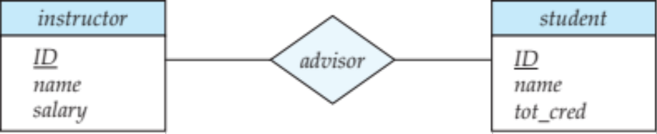
Representing Relationship Sets via ER Diagrams
Diamonds represent relationship sets.

Slide 36
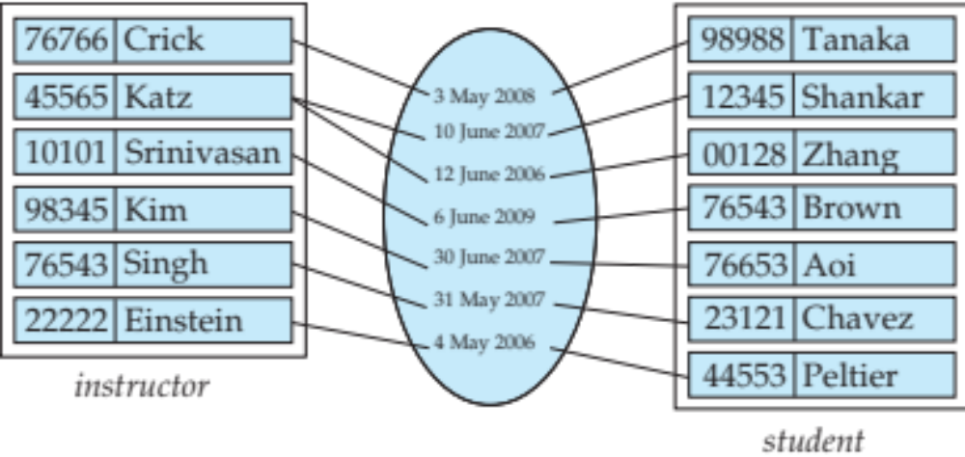
Relationship Sets
An attribute can also be associated with a relationship set.
For instance, the advisor relationship set between entity sets instructor and student may have the attribute date which tracks when the student started being associated with the advisor

Slide 37
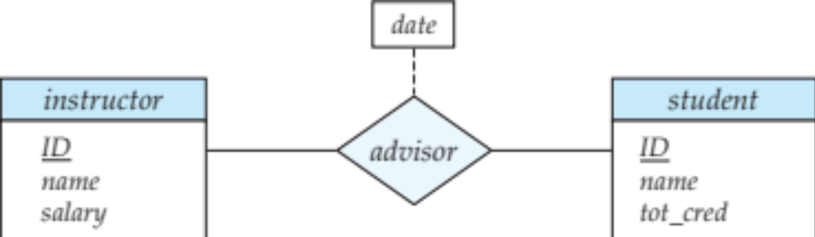
Relationship Sets with Attributes

Slide 38
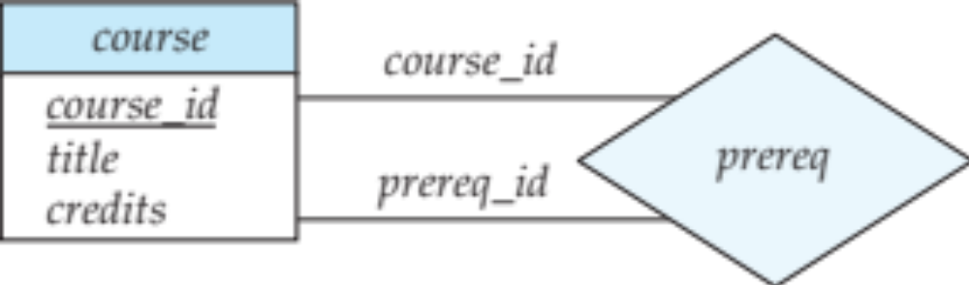
Roles
Entity sets of a relationship need not be distinct
  Each occurrence of an entity set plays a “role” in the relationship
The labels “course_id” and “prereq_id” are called roles.

Slide 39
Degree of a Relationship Set
Binary relationship
  involve two entity sets (or degree two).
  most relationship sets in a database system are binary.
Relationships between more than two entity sets are rare. Most relationships are binary. (More on this later.)
  Example: students work on research projects under the guidance of an instructor.
  relationship proj_guide is a ternary relationship between instructor, student, and project

Slide 40
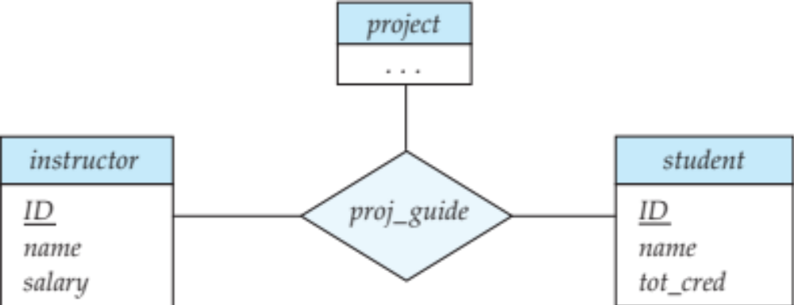
Non-binary Relationship Sets
Most relationship sets are binary
There are occasions when it is more convenient to represent relationships as non-binary.
E-R Diagram with a Ternary Relationship

Slide 41
Complex Attributes
Attribute types:
  Simple and composite attributes.
  Single-valued and multivalued attributes
    Example: multivalued attribute: phone_numbers
  Derived attributes
    Can be computed from other attributes
    Example: age, given date_of_birth
Domain – the set of permitted values for each attribute

Slide 42
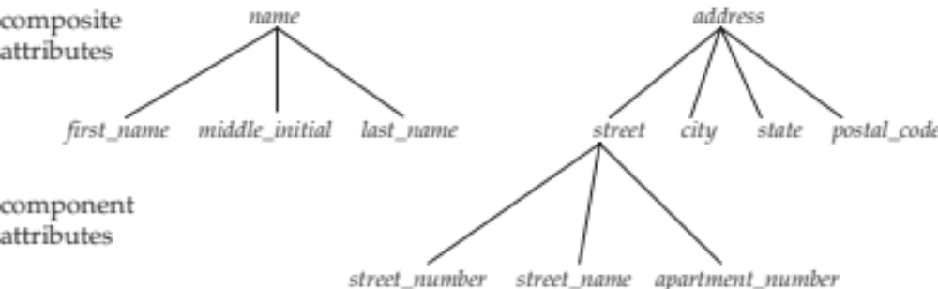
Composite Attributes
Composite attributes allow us to divided attributes into subparts (other attributes).

Slide 43
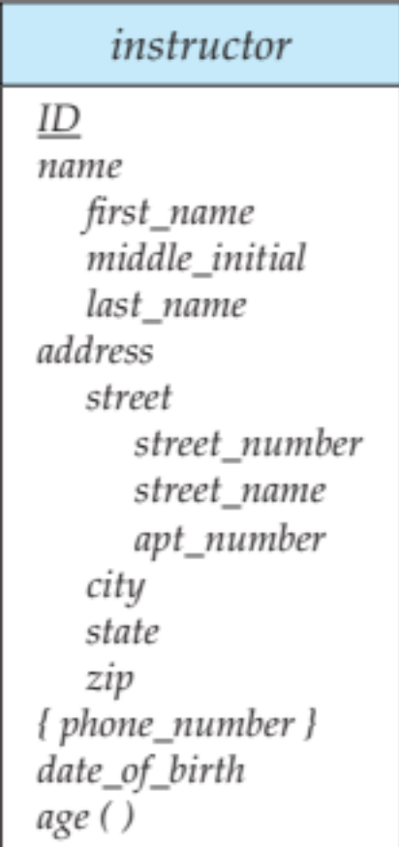
Representing Complex Attributes in ER Diagram

Slide 44
Mapping Cardinality Constraints
Express the number of entities to which another entity can be associated via a relationship set.
Most useful in describing binary relationship sets.
For a binary relationship set the mapping cardinality must be one of the following types:
  One to one
  One to many
  Many to one
  Many to many

Slide 45

Mapping Cardinalities
One to one
One to many
Note: Some elements in A and B may not be mapped to any
elements in the other set

Slide 46
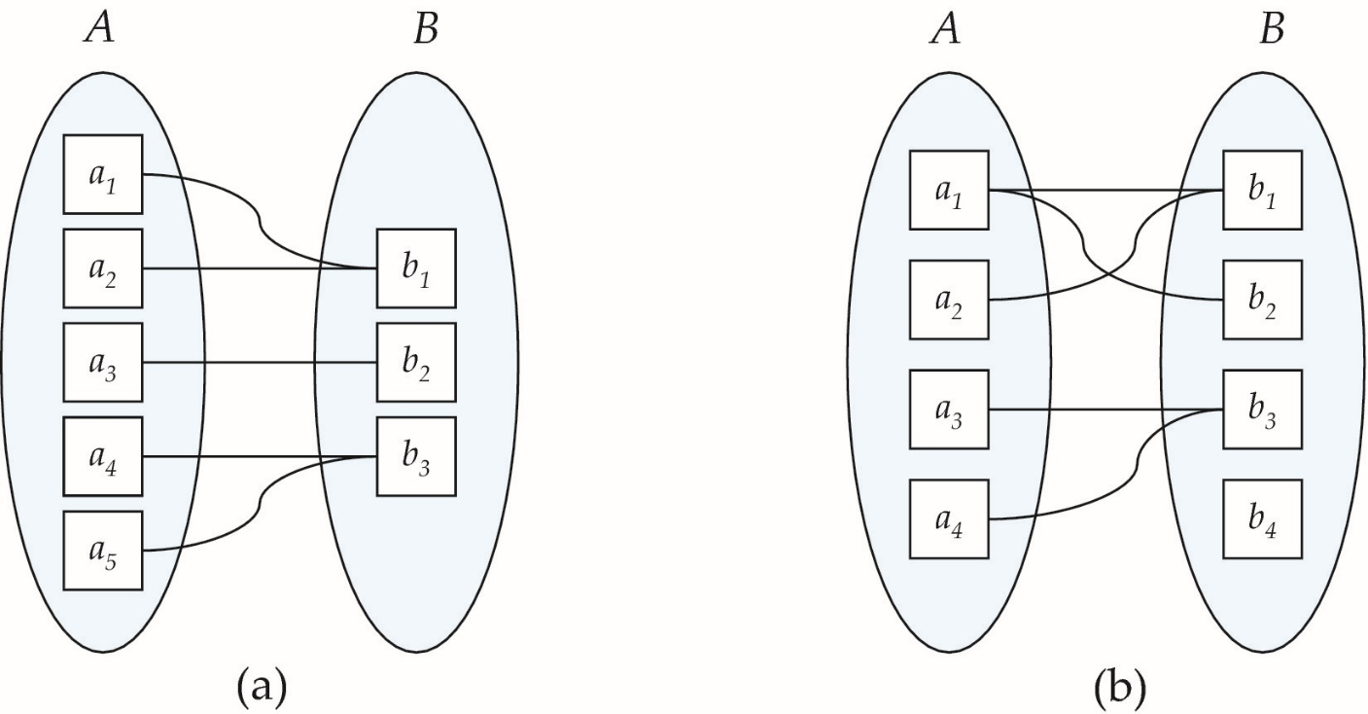
Mapping Cardinalities
Many to one
Many to many
Note: Some elements in A and B may not be mapped to any
elements in the other set

Slide 47
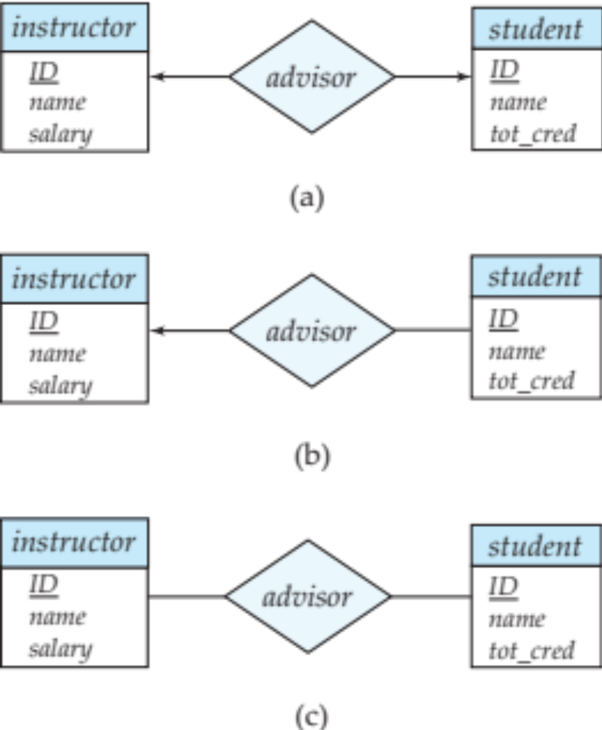
Representing Cardinality Constraints in ER Diagram
We express cardinality constraints by drawing either a directed line (→), signifying “one,” or an undirected line (—), signifying “many,” between the relationship set and the entity set.
One-to-one relationship between an instructor and a student :
  A student is associated with at most one instructor via the relationship advisor
  A student is associated with at most one department via stud_dept

Slide 48
One-to-Many Relationship
one-to-many relationship between an instructor and a student
  an instructor is associated with several (including 0) students via advisor
  a student is associated with at most one instructor via advisor,

Slide 49
Many-to-One Relationships
In a many-to-one relationship between an instructor and a student,
  an instructor is associated with at most one student via advisor,
  and a student is associated with several (including 0) instructors via advisor

Slide 50
Many-to-Many Relationship
An instructor is associated with several (possibly 0) students via advisor
A student is associated with several (possibly 0) instructors via advisor

Slide 51
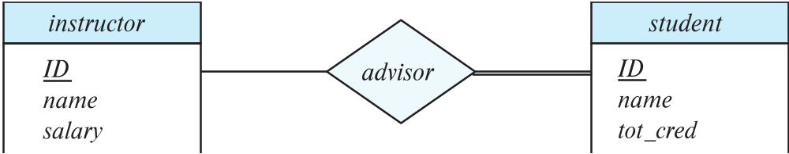
Total and Partial Participation
Total participation (indicated by double line): every entity in the entity set participates in at least one relationship in the relationship set
  participation of student in advisor relation is total
    every student must have an associated instructor
Partial participation: some entities may not participate in any relationship in the relationship set
  Example: participation of instructor in advisor is partial

Slide 52
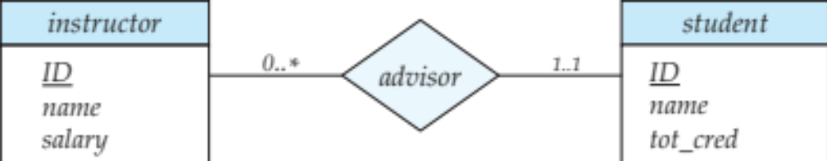
Notation for Expressing More Complex Constraints
A line may have an associated minimum and maximum cardinality, shown in the form l..h, where l is the minimum and h the maximum cardinality
  A minimum value of 1 indicates total participation.
  A maximum value of 1 indicates that the entity participates in at most one relationship
  A maximum value of * indicates no limit.
Example
  Instructor can advise 0 or more students. A student must have 1 advisor; cannot have multiple advisors

Slide 53
Cardinality Constraints on Ternary Relationship
We allow at most one arrow out of a ternary (or greater degree) relationship to indicate a cardinality constraint
For example, an arrow from proj_guide to instructor indicates each student has at most one guide for a project
If there is more than one arrow, there are two ways of defining the meaning.
  For example, a ternary relationship R between A, B and C with arrows to B and C could mean
    1. Each A entity is associated with a unique entity from B
    and C or
    2. Each pair of entities from (A, B) is associated with a unique C entity, and each pair (A, C) is associated with a unique B
  Each alternative has been used in different formalisms
  To avoid confusion we outlaw more than one arrow

Slide 54
Primary Key
Primary keys provide a way to specify how entities and relations are distinguished. We will consider:
  Entity sets
  Relationship sets.
  Weak entity sets

Slide 55
Primary key for Entity Sets
By definition, individual entities are distinct.
From database perspective, the differences among them must be expressed in terms of their attributes.
The values of the attribute values of an entity must be such that they can uniquely identify the entity.
  No two entities in an entity set are allowed to have exactly the same value for all attributes.
A key for an entity is a set of attributes that suffice to distinguish entities from each other

Slide 56
Primary Key for Relationship Sets
To distinguish among the various relationships of a relationship set we use the individual primary keys of the entities in the relationship set.
  Let R be a relationship set involving entity sets E1, E2, .. En
  The primary key for R is consists of the union of the primary keys of entity sets E1, E2, ..En
  If the relationship set R has attributes a1, a2, .., am associated with it, then the primary key of R also includes the attributes a1, a2, .., am
Example: relationship set “advisor”.
  The primary key consists of instructor.ID and student.ID
The choice of the primary key for a relationship set depends on the mapping cardinality of the relationship set.

Slide 57
Choice of Primary key for Binary Relationship
Many-to-Many relationships. The preceding union of the primary keys is a minimal superkey and is chosen as the primary key.
One-to-Many relationships . The primary key of the “Many” side is a minimal superkey and is used as the primary key.
Many-to-one relationships. The primary key of the “Many” side is a minimal superkey and is used as the primary key.
One-to-one relationships. The primary key of either one of the participating entity sets forms a minimal superkey, and either one can be chosen as the primary key.

Slide 58
Weak Entity Sets
Consider a section entity, which is uniquely identified by a course_id, semester, year, and sec_id.
Clearly, section entities are related to course entities. Suppose we create a relationship set sec_course between entity sets section and course.
Note that the information in sec_course is redundant, since section already has an attribute course_id, which identifies the course with which the section is related.
One option to deal with this redundancy is to get rid of the relationship sec_course; however, by doing so the relationship between section and course becomes implicit in an attribute, which is not desirable.

Slide 59
Weak Entity Sets
An alternative way to deal with this redundancy is to not store the attribute course_id in the section entity and to only store the remaining attributes section_id, year, and semester.
  However, the entity set section then does not have enough attributes to identify a particular section entity uniquely
To deal with this problem, we treat the relationship sec_course as a special relationship that provides extra information, in this case, the course_id, required to identify section entities uniquely.
A weak entity set is one whose existence is dependent on another entity, called its identifying entity
Instead of associating a primary key with a weak entity, we use the identifying entity, along with extra attributes called discriminator to uniquely identify a weak entity.

Slide 60
Weak Entity Sets
An entity set that is not a weak entity set is termed a strong entity set.
Every weak entity must be associated with an identifying entity; that is, the weak entity set is said to be existence dependent on the identifying entity set.
The identifying entity set is said to own the weak entity set that it identifies.
The relationship associating the weak entity set with the identifying entity set is called the identifying relationship.
Note that the relational schema we eventually create from the entity set section does have the attribute course_id, for reasons that will become clear later, even though we have dropped the attribute course_id from the entity set section.

Slide 61
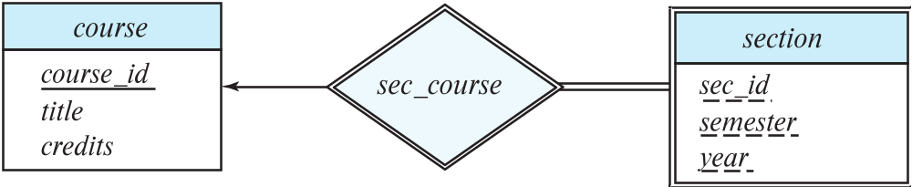
Expressing Weak Entity Sets
In E-R diagrams, a weak entity set is depicted via a double rectangle.
We underline the discriminator of a weak entity set with a dashed line.
The relationship set connecting the weak entity set to the identifying strong entity set is depicted by a double diamond.
Primary key for section – (course_id, sec_id, semester, year)

Slide 62
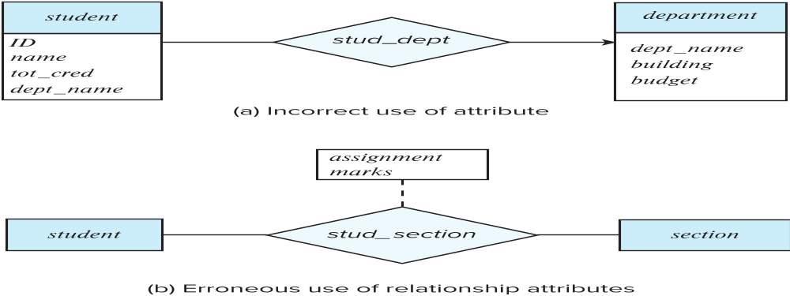
Redundant Attributes
Suppose we have entity sets:
  student, with attributes: ID, name, tot_cred, dept_name
  department, with attributes: dept_name, building, budget
We model the fact that each student has an associated department using a relationship set stud_dept
The attribute dept_name in student below replicates information present in the relationship and is therefore redundant
  and needs to be removed.
BUT: when converting back to tables, in some cases the attribute gets reintroduced, as we will see later.

Slide 63
Schema of University Database
classroom(building, room number, capacity)
department(dept name, building, budget)
course(course id, title, dept name, credits)
instructor(ID, name, dept name, salary)
section(course id, sec id, semester, year, building, room number, time slot id)
teaches(ID, course id, sec id, semester, year)
student(ID, name, dept name, tot cred)
takes(ID, course id, sec id, semester, year, grade)
advisor(s ID, i ID)
time slot(time slot id, day, start time, end time)
Prereq (course id, prereq id)

Slide 64
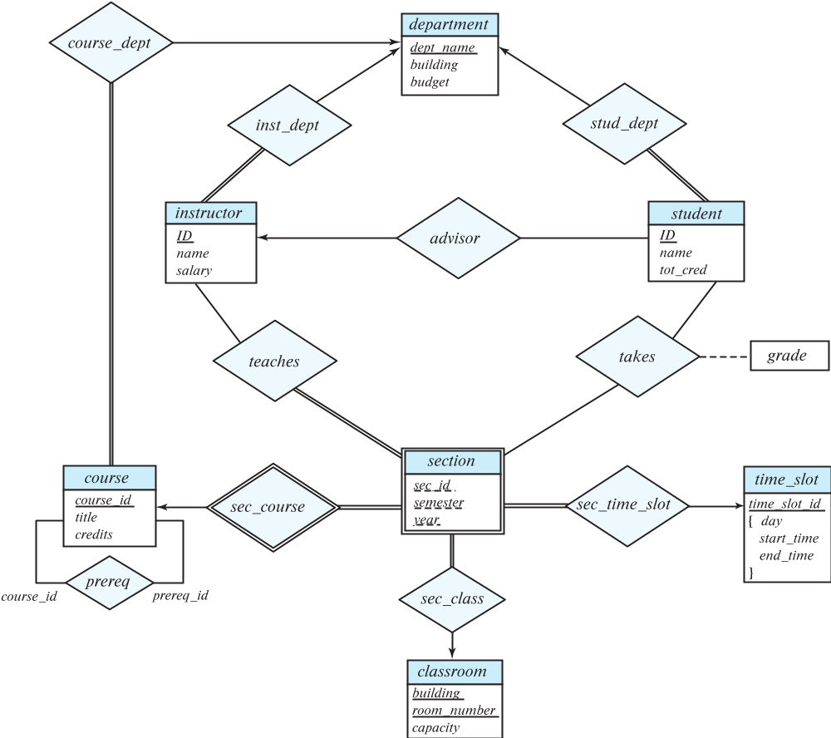
E-R Diagram for a University Enterprise

Slide 65
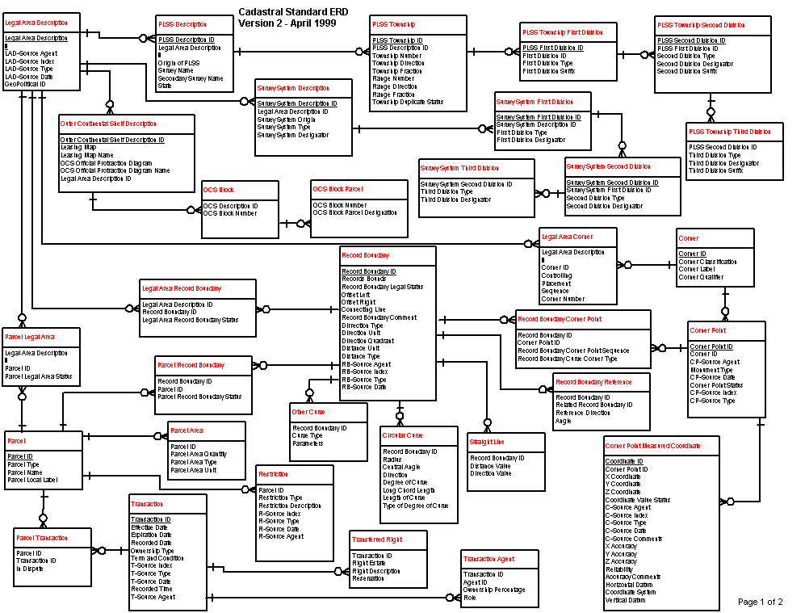
A Cadastral E-R Diagram

Slide 66
A Cadastral E-R Diagram
cadastral: showing or recording property boundaries, subdivision lines, buildings, and related details
Source: US Dept. Interior Bureau of Land Management,
Federal Geographic Data Committee Cadastral Subcommittee
http://www.fairview-industries.com/standardmodule/cad-erd.htm

Slide 67
Reduction to Relation Schemas

Slide 68
Reduction to Relation Schemas
Entity sets and relationship sets can be expressed uniformly as relation schemas that represent the contents of the database.
A database which conforms to an E-R diagram can be represented by a collection of schemas.
For each entity set and relationship set there is a unique schema that is assigned the name of the corresponding entity set or relationship set.
Each schema has a number of columns (generally corresponding to attributes), which have unique names.

Slide 69
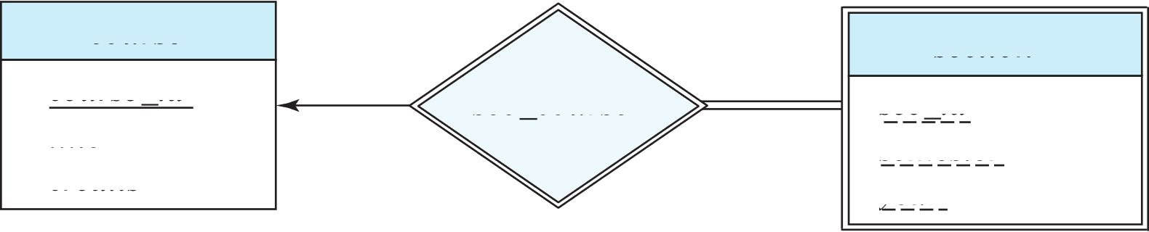
Representing Entity Sets
A strong entity set reduces to a schema with the same attributes
student(ID, name, tot_cred)
A weak entity set becomes a table that includes a column for the primary key of the identifying strong entity set
section ( course_id, sec_id, sem, year )
Example

Slide 70
Representation of Entity Sets with Composite Attributes
Composite attributes are flattened out by creating a separate attribute for each component attribute
  Example: given entity set instructor with composite attribute name with component attributes first_name and last_name the schema corresponding to the entity set has two attributes name_first_name and name_last_name
    Prefix omitted if there is no ambiguity (name_first_name could be first_name)
Ignoring multivalued attributes, extended instructor schema is
  instructor(ID,
  first_name, middle_initial, last_name,
  street_number, street_name,
  apt_number, city, state, zip_code,
  date_of_birth)

Slide 71
Representation of Entity Sets with Multivalued Attributes
A multivalued attribute M of an entity E is represented by a separate schema EM
Schema EM has attributes corresponding to the primary key of E and an attribute corresponding to multivalued attribute M
Example: Multivalued attribute phone_number of instructor is represented by a schema:
inst_phone= ( ID, phone_number)
Each value of the multivalued attribute maps to a separate tuple of the relation on schema EM
  For example, an instructor entity with primary key 22222 and phone numbers 456-7890 and 123-4567 maps to two tuples:
  (22222, 456-7890) and (22222, 123-4567)

Slide 72
Representing Relationship Sets
A many-to-many relationship set is represented as a schema with attributes for the primary keys of the two participating entity sets, and any descriptive attributes of the relationship set.
Example: schema for relationship set advisor
advisor = (s_id, i_id)

Slide 73
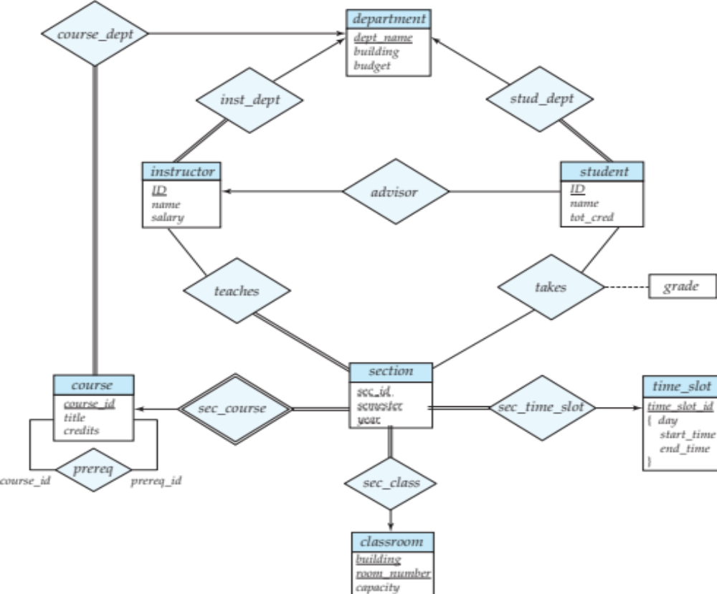
Redundancy of Schemas
Many-to-one and one-to-many relationship sets that are total on the many-side can be represented by adding an extra attribute to the “many” side, containing the primary key of the “one” side
Example: Instead of creating a schema for relationship set inst_dept, add an attribute dept_name to the schema arising from entity set instructor
Example

Slide 74
Redundancy of Schemas
For one-to-one relationship sets, either side can be chosen to act as the “many” side
  That is, an extra attribute can be added to either of the tables corresponding to the two entity sets
If participation is partial on the “many” side, replacing a schema by an extra attribute in the schema corresponding to the “many” side could result in null values

Slide 75
Redundancy of Schemas
The schema corresponding to a relationship set linking a weak entity set to its identifying strong entity set is redundant.
Example: The section schema already contains the attributes that would appear in the sec_course schema
Section ( Course_ID, sect_ID,semester, year, building,room_number,timeslot_ID)
Course ( Course_ID, title, dept_name, credits)
Sec_Course

Slide 76
Extended E-R Features

Slide 77
Specialization
Top-down design process; we designate sub-groupings within an entity set that are distinctive from other entities in the set.
These sub-groupings become lower-level entity sets that have attributes or participate in relationships that do not apply to the higher-level entity set.
Depicted by a triangle component labeled ISA (e.g., instructor “is a” person).
Attribute inheritance – a lower-level entity set inherits all the attributes and relationship participation of the higher-level entity set to which it is linked.

Slide 78
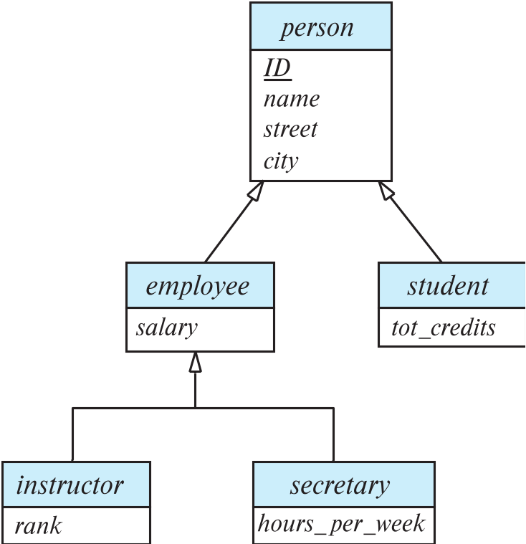
Specialization Example
Overlapping – employee and student
Disjoint – instructor and secretary
Total and partial

Slide 79
Constraints
Overlapping Constraint
Overlapping: student, employee, 2 separate arrows
Disjoint: Instructor, secretary, single arrow
Completeness Constraint
Total: drawing dashed line from keyword ‘total’ to hollow arrowhead/s
Partial: default
Partial-overlapping, partial-disjoint, total-overlapping, total-disjoint

Slide 80
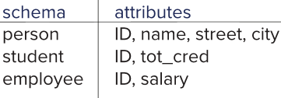
Representing Specialization via Schemas
Method 1:
  Form a schema for the higher-level entity
  Form a schema for each lower-level entity set, include primary key of higher-level entity set and local attributes
  Drawback: getting information about, an employee requires accessing two relations, the one corresponding to the low-level schema and the one corresponding to the high-level schema

Slide 81
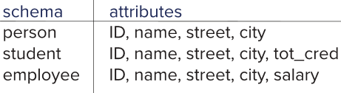
Representing Specialization as Schemas
Method 2:
  Form a schema for each entity set with all local and inherited attributes
  Drawback: name, street and city may be stored redundantly for people who are both students and employees

Slide 82
Generalization
A bottom-up design process – combine a number of entity sets that share the same features into a higher-level entity set.
Specialization and generalization are simple inversions of each other; they are represented in an E-R diagram in the same way.
The terms specialization and generalization are used interchangeably.

Slide 83
Completeness constraint
Completeness constraint -- specifies whether or not an entity in the higher-level entity set must belong to at least one of the lower-level entity sets within a generalization.
  total: an entity must belong to one of the lower-level entity sets
  partial: an entity need not belong to one of the lower-level entity sets

Slide 84
Completeness constraint
Partial generalization is the default.
We can specify total generalization in an ER diagram by adding the keyword total in the diagram and drawing a dashed line from the keyword to the corresponding hollow arrow-head to which it applies (for a total generalization), or to the set of hollow arrow-heads to which it applies (for an overlapping generalization).
The student generalization is total: All student entities must be either graduate or undergraduate. Because the higher-level entity set arrived at through generalization is generally composed of only those entities in the lower-level entity sets, the completeness constraint for a generalized higher-level entity set is usually total

Slide 85
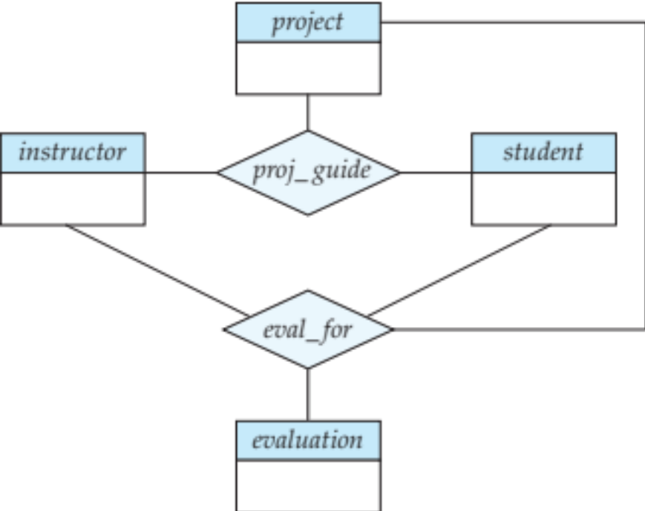
Aggregation
Consider the ternary relationship proj_guide, which we saw earlier
Suppose we want to record evaluations of a student by a guide on a project

Slide 86
Aggregation
Relationship sets eval_for and proj_guide represent overlapping information
  Every eval_for relationship corresponds to a proj_guide relationship
  However, some proj_guide relationships may not correspond to any eval_for relationships
    So we can’t discard the proj_guide relationship
Eliminate this redundancy via aggregation
  Treat relationship as an abstract entity
  Allows relationships between relationships
  Abstraction of relationship into new entity

Slide 87
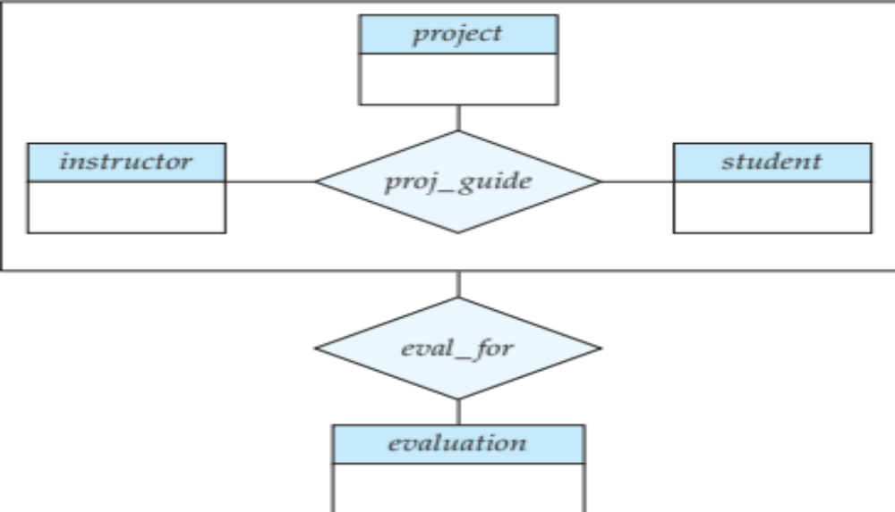
Aggregation
Eliminate this redundancy via aggregation without introducing redundancy, the following diagram represents:
  A student is guided by a particular instructor on a particular project
  A student, instructor, project combination may have an associated evaluation

Slide 88
Reduction to Relational Schemas
To represent aggregation, create a schema containing
  Primary key of the aggregated relationship,
  The primary key of the associated entity set
  Any descriptive attributes
In our example:
  The schema eval_for is:
  eval_for (s_ID, project_id, i_ID, evaluation_id)
  The schema proj_guide is redundant.

Slide 89
Design Issues

Slide 90

Common Mistakes in E-R Diagrams
Example of erroneous E-R diagrams

Slide 91
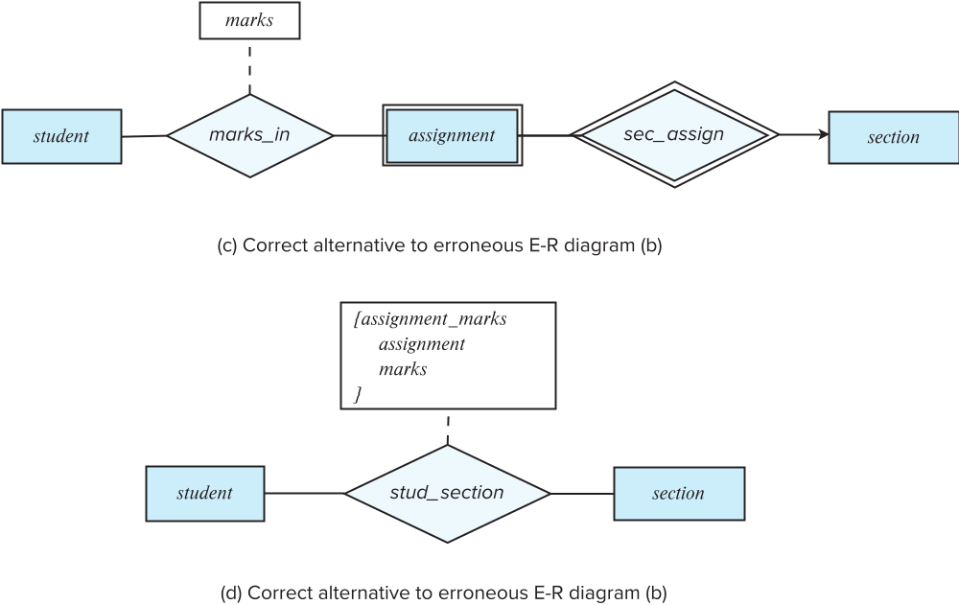
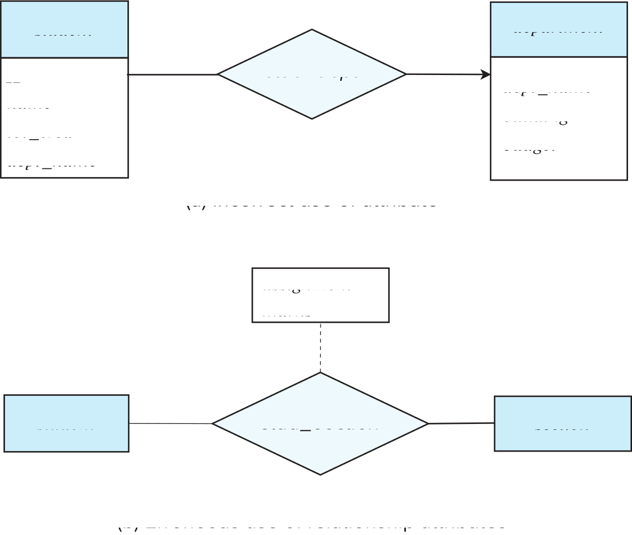
Common Mistakes in E-R Diagrams

Slide 92
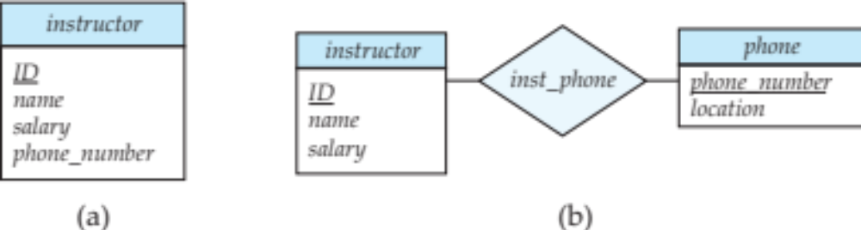
Entities vs. Attributes
Use of entity sets vs. attributes
Use of phone as an entity allows extra information about phone numbers (plus multiple phone numbers)

Slide 93
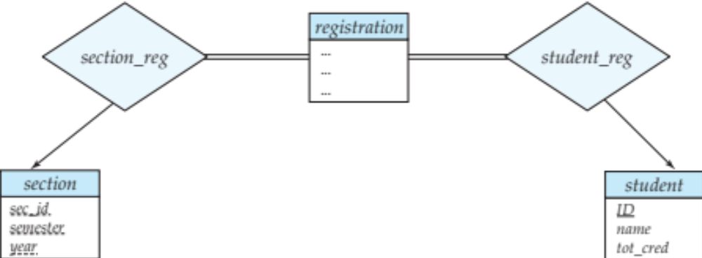
Entities vs. Relationship sets
Use of entity sets vs. relationship sets
Possible guideline is to designate a relationship set to describe
  an action that occurs between entities
Placement of relationship attributes
For example, attribute date as attribute of advisor or as attribute of student

Slide 94

Binary Vs. Non-Binary Relationships
Although it is possible to replace any non-binary (n-ary, for n > 2) relationship set by a number of distinct binary relationship sets, a n-ary relationship set shows more clearly that several entities participate in a single relationship.
Some relationships that appear to be non-binary may be better represented using binary relationships
  For example, a ternary relationship parents, relating a child to his/her father and mother, is best replaced by two binary relationships, father and mother
    Using two binary relationships allows partial information (e.g., only mother being known)
  But there are some relationships that are naturally non-binary
    Example: proj_guide

Slide 95
Binary Vs. Non-Binary Relationships
  For example, a ternary relationship parents, relating a child to his/her father and mother, is best replaced by two binary relationships, father and mother
    Using two binary relationships allows partial information (e.g., only mother being known)
    Parents ( Child , father, mother)
    P-M ( child, mother)
    P-F (Child, father)
  But there are some relationships that are naturally non-binary
    Example: proj_guide
    Proj_guide (student, project, instructor)

Slide 96
Binary vs. Ternary Relationships
quantity
Parts
Contract
Departments
VS.
Suppliers
Parts
needs
Departments
can-supply
Suppliers
deals-with
  S “can-supply” P, D “needs” P, and D “deals-with” S does not imply that D has agreed to buy P from S.
  How do we record qty?
Notes:
9

Slide 97
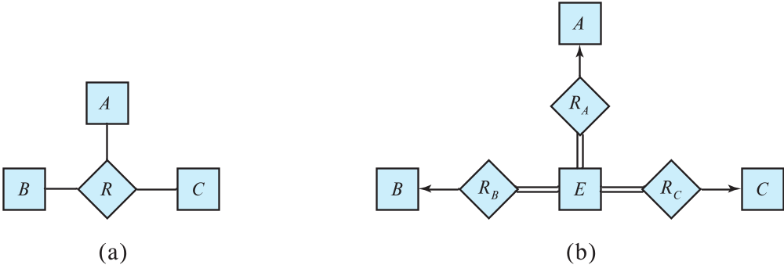
Converting Non-Binary Relationships to Binary Form
In general, any non-binary relationship can be represented using binary relationships by creating an artificial entity set.
  Replace R between entity sets A, B and C by an entity set E, and three relationship sets:
1. R_{A}, relating E and A 2. R_{B}, relating E and B
3. R_{C}, relating E and C
  Create an identifying attribute for E and add any attributes of R to E
  For each relationship (a_{i} , b_{i} , c_{i}) in R, create
1. a new entity e_{i} in the entity set E 2. add (e_{i} , a_{i} ) to R_{A}
3. add (e_{i} , b_{i} ) to R_{B} 4. add (e_{i} , c_{i} ) to R_{C}

Slide 98
Converting Non-Binary Relationships
Also need to translate constraints
  Translating all constraints may not be possible
  There may be instances in the translated schema that
  cannot correspond to any instance of R
    Exercise: add constraints to the relationships R_{A}, R_{B} and R_{C} to ensure that a newly created entity corresponds to exactly one entity in each of entity sets A, B and C
  We can avoid creating an identifying attribute by making E a weak entity set (described shortly) identified by the three relationship sets

Slide 99
Binary vs. Ternary Relationships
name
ssn
lot
pname
age
Employees
Covers
Dependents
If each policy is owned by just 1 employee, and each dependent is tied to the covering policy, first diagram is inaccurate.
What are the additional constraints in the 2nd diagram?
Bad design
Policies
policyid
cost
name
pname
age
ssn
lot
Dependents
Employees
Purchaser
Beneficiary
Better design
Policies
policyid
cost
Notes:
7

Slide 100
New Constraints
Employee can be identified by e_ID
Employee can purchase several policies
Policy can be purchased by only one employee
Every policy must be purchased by an employee
Policy benefits several dependents
A dependent gets benefited by one policy
Every dependent must get benefited by a policy
Dependents is a weak entity set
Beneficiary is a relationship connecting weak entity set with strong/owner entity set
Pname is partial key for dependents
Identifier for dependents is (pname, ssn)

Slide 101
Choice of Primary key for Binary Relationship
Many-to-Many relationships. The preceding union of the primary keys is a minimal superkey and is chosen as the primary key.
One-to-Many relationships . The primary key of the “Many” side is a minimal superkey and is used as the primary key.
Many-to-one relationships. The primary key of the “Many” side is a minimal superkey and is used as the primary key.
One-to-one relationships. The primary key of either one of the participating entity sets forms a minimal superkey, and either one can be chosen as the primary key.

Slide 102
One to Many
CREATE TABLE Employee(
e_ID CHAR(11),
e_name CHAR (11),
designation CHAR(8),
PRIMARY KEY (e_ID)
)
Create Table Department(
Did
Dname
Budget
PRIMARY KEY did
)

Slide 103
Approach 1
CREATE TABLE Manages(
e_ID CHAR(11),
did INTEGER,
since DATE,
PRIMARY KEY (did),
FOREIGN KEY (e_ID) REFERENCES Employees,
FOREIGN KEY (did) REFERENCES Departments)

Slide 104
Approach 2
CREATE TABLE Dept_Mgr(
did INTEGER,
dname CHAR(20),
budget REAL,
e_ID CHAR(11),
since DATE,
PRIMARY KEY (did),
FOREIGN KEY (e_ID)
REFERENCES Employees)

Slide 105
E-R Design Decisions
The use of an attribute or entity set to represent an object.
Whether a real-world concept is best expressed by an entity set or a relationship set.
The use of a ternary relationship versus a pair of binary relationships.
The use of a strong or weak entity set.
The use of specialization/generalization – contributes to modularity in the design.
The use of aggregation – can treat the aggregate entity set as a single unit without concern for the details of its internal structure.

Slide 106
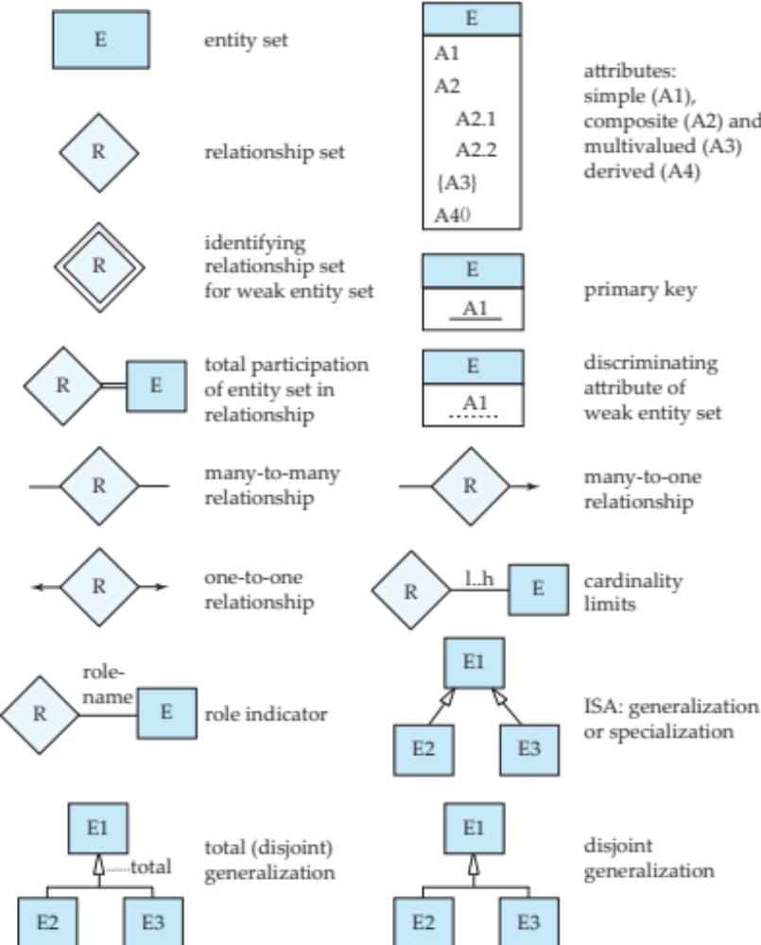
Summary of Symbols Used in E-R Notation

Slide 107
Symbols Used in E-R Notation

Slide 108
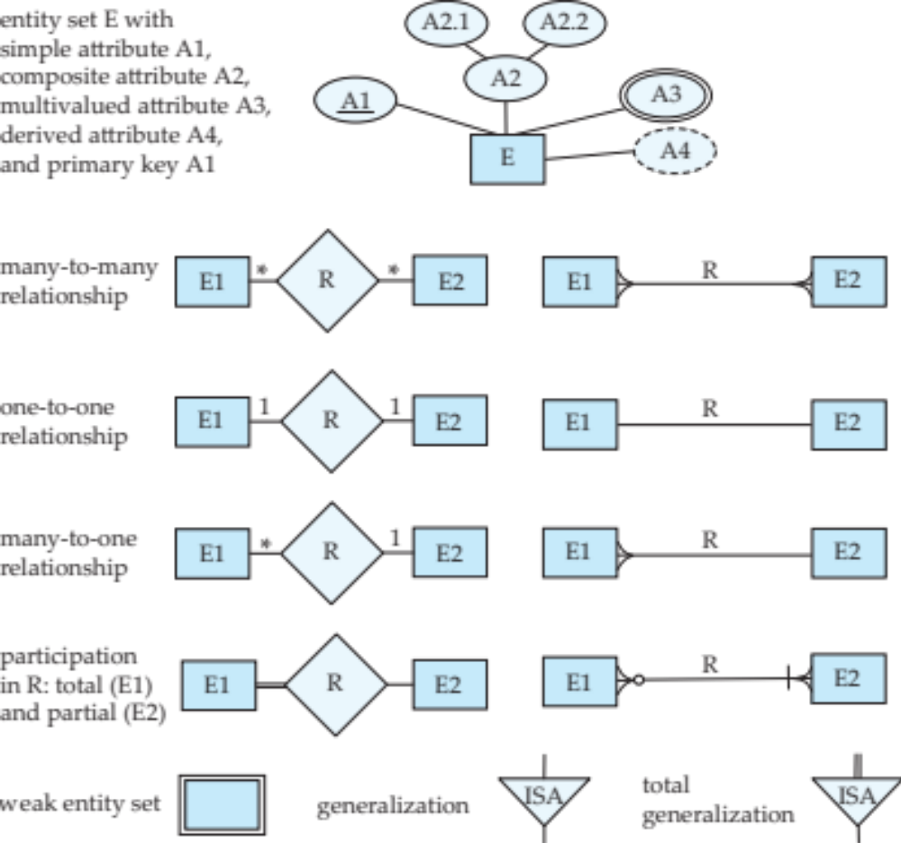
Alternative ER Notations
Chen, IDE1FX, …

Slide 109
Alternative ER Notations
Chen IDE1FX (Crows feet notation)

Slide 110
UML
UML: Unified Modeling Language
UML has many components to graphically model different aspects of an entire software system
UML Class Diagrams correspond to E-R Diagram, but several differences.

Slide 111
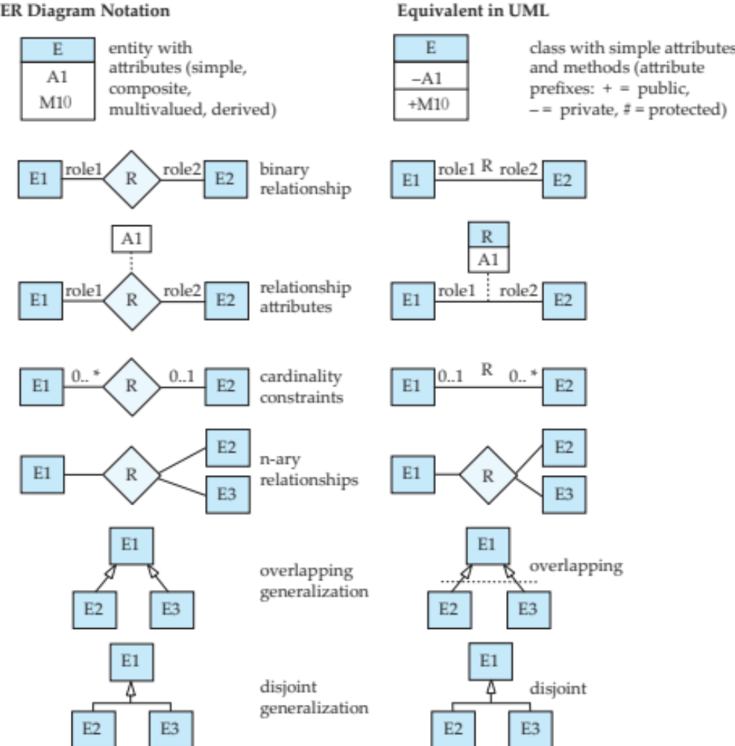
ER vs. UML Class Diagrams
* Note reversal of position in cardinality constraint depiction

Slide 112
ER vs. UML Class Diagrams
ER Diagram Notation
Equivalent in UML
* Generalization can use merged or separate arrows independent
of disjoint/overlapping

Slide 113
UML Class Diagrams
Binary relationship sets are represented in UML by just drawing a line connecting the entity sets. The relationship set name is written adjacent to the line.
The role played by an entity set in a relationship set may also be specified by writing the role name on the line, adjacent to the entity set.
The relationship set name may alternatively be written in a box, along with attributes of the relationship set, and the box is connected, using a dotted line, to the line depicting the relationship set.

Slide 114
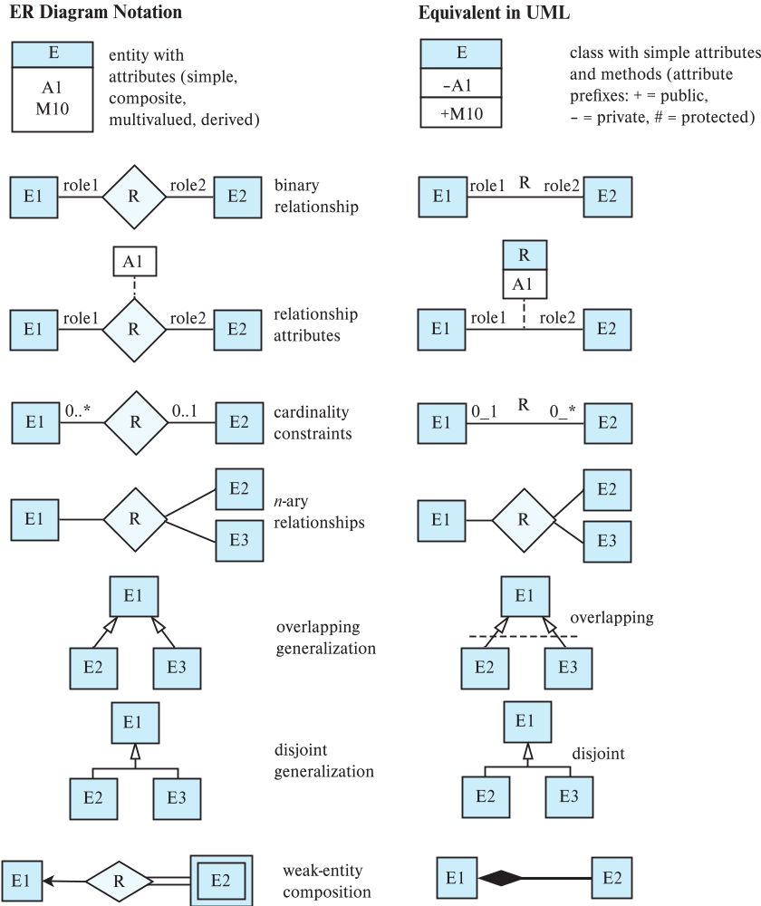
ER vs. UML Class Diagrams

Slide 115
Other Aspects of Database Design
Functional Requirements
Data Flow, Workflow
Schema Evolution

